Slide 1
CSS Preprocessor
by Yurii Martynenko

Slide 2
Agenda
Introduction to CSS Processing Tools
Syntax
Sass
Installation
Variables
Nesting
Partials and Import
Mixins
Extend
Operators
Control Flow Statements
PostCSS

Slide 3



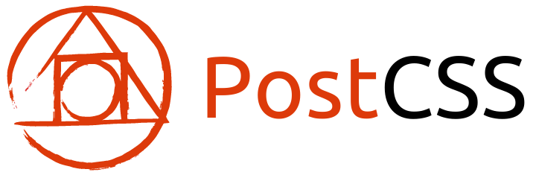
Introduction to CSS Processing Tools
Most web projects require much of CSS code.
CSS language is difficult to maintain because it has limited ability to use constructions that are common for algorithmic languages like variables, loops, conditions, calculations etc.
That's why most developers prefer to use special tools called preprocessors that extend CSS language to make it easier to maintain and then convert such code to standard CSS language supported by browsers.
The most popular CSS preprocessors are Sass, LESS, Stylus.
With the introduction of PostCSS also emerged another class of tools related to processing of CSS with very powerful features.
Notes:
Сучасні веб-проекти вимагають створення значного обсягу коду з використанням мови CSS.
Проте підтримка великих обсягів коду на CSS є надзвичайно складною, оскільки мова має дуже обмежені можливості у використанні типових конструкцій популярних алгоритмічних мов, таких як змінні, цикли, умови, проведення обчислень і тому подібне.
Це і стало основною причиною виникнення і поширення серед веб-розробників спеціальної категорії інструментів, які мають назву "Препроцесори CSS", що розширюють синтаксис і можливості мови CSS, спрощуючи її підтримку, і дозволяють конвертувати такий розширений код у стандартну мову CSS, яка зрозуміла браузерам.
Найбільш популярними CSS-препроцесорами є Sass, LESS і Stylus.
Однак з появою PostCSS виник інший клас інструментів, призначений для обробки CSS, який має дуже потужні можливості. Варіанти використання PostCSS є надзвичайно гнучкими, цей інструмент може як замінити собою препроцесори повністю, так і використовуватися разом з ними.
Спочатку ми розглянемо роботу з препроцессором Sass, а потім познайомимося з PostCSS.

Slide 4
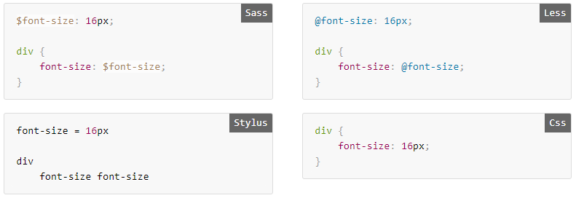
Syntax

Slide 5
Sass/SCSS Sass is CSS. But only better.
Yurii Martynenko

Slide 6

What is Sass?
Sass (Syntatically Awesome Style Sheets) - is the most popular and mature CSS pre-processing language, first appeared in 2006
It supports two syntaxes:
original SASS syntax similar to Haml that is not compatible with CSS
new SCSS syntax that is very close to CSS as any syntactically valid CSS file is also valid SCSS file
Originally written in Ruby and reguired Ruby to work
In 2012 introduced C++ implementation called libSass that doesn't require Ruby

Slide 7
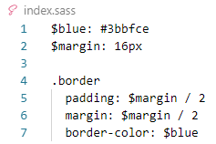
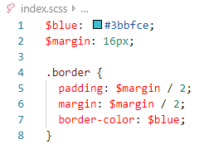
Syntax Sass & SCSS

Slide 8
Installation
If you use Node.js, you can install Sass using npm by running
When you install Sass on the command line, you'll be able to run the sass executable to compile .sass and .scss files to .css files. For example:
If you wanted to watch (instead of manually build) your input.scss file, you'd just add the watch flag to your command, like so:
You can watch and output to directories by using folder paths as your input and output, and separating them with a colon. In this example:
Sass would watch all files in the app/sass folder for changes, and compile CSS to the public/stylesheets folder.
npm install -g sass
sass source/stylesheets/index.scss build/stylesheets/index.css
sass --watch input.scss output.css
sass --watch app/sass:public/stylesheets

Slide 9
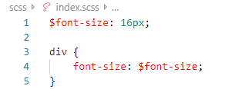
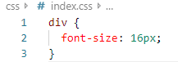
Variables
Variables in SASS allow to store and re-use information through stylesheets.
Sass uses $ symbol for variables.
Example:

Slide 10
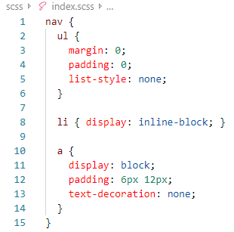
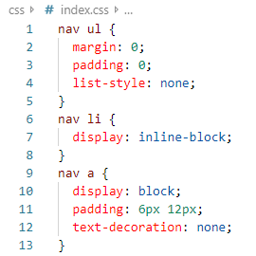
Nesting
HTML implies that elements are nested inside each other but CSS does not
Sass fixes this allowing to nest CSS selectors in a way that follows same visual hierarchy of HTML
Example:

Slide 11
Partials
You can create partial Sass files that contain little snippets of CSS that you can include in other Sass files. This is a great way to modularize your CSS and help keep things easier to maintain.
A partial is simply a Sass file named with a leading underscore. You might name it something like _partial.scss. The underscore lets Sass know that the file is only a partial file and that it should not be generated into a CSS file.
Sass partials are used with the @import directive.

Slide 12
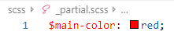
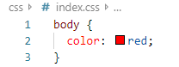
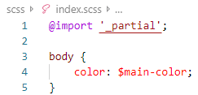
Import
CSS has an import option that lets you split your CSS into smaller, more maintainable portions. The only drawback is that each time you use @import in CSS it creates another HTTP request. Sass builds on top of the current CSS @import but instead of requiring an HTTP request, Sass will take the file that you want to import and combine it with the file you're importing into so you can serve a single CSS file to the web browser.

Slide 13
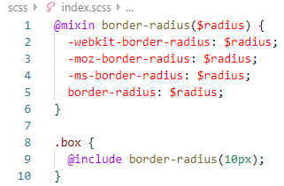
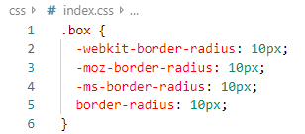
Mixins
Mixins allow to create groups of CSS declarations that can be reused throughout the site.
It is possible to pass in values to make mixins more flexible.
To create them use @mixin directive, to use - @include followed by mixin name:

Slide 14
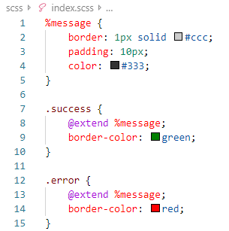
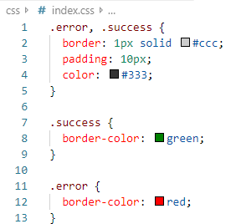
Extend
Sass allows to share CSS properties from one selector to another with directive @extend
Extends are similar to mixins but can't take parameters, in most cases extends produce more compact code by combining selectors
Use '%' before selector name to tell Sass not to include it in generated code.

Slide 15
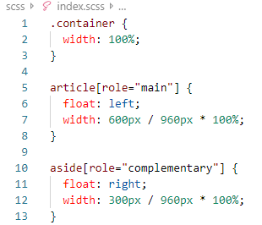
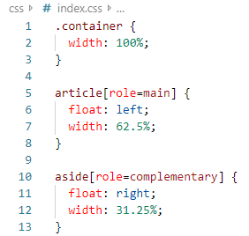
Operators
Sass allows to make math calculations with standard operators like +, -, *, /, and %

Slide 16
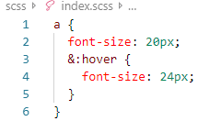
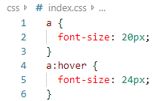
Referencing Parent Selectors: &
& will be replaced with the parent selector as it appears in the CSS

Slide 17
Control Flow Statements
Sass supports control flow statements to create conditions and loops with directives @if, @else, @for, @each, @while.

Slide 18
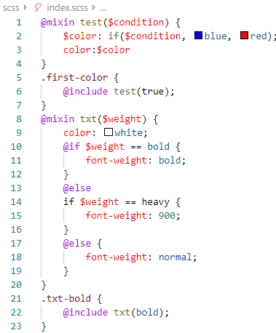
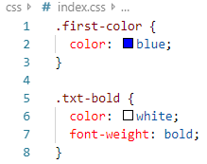
If/Else Statements
Control directives and expressions help to build similar style definitions according to matched conditions or variables

Slide 19
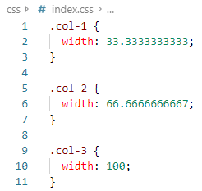
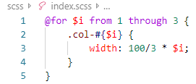
Loops
Loops are useful when iterating through an array or creating a series of styles as in grid widths.

Slide 20
PostCSS
Yurii Martynenko

Slide 21
What is PostCSS?
PostCSS is a new generation tool to process CSS, it represents modular platform based on plugins that can do wide variety of tasks with styles, some of them are:
Automatically adds vendor prefixes
Allows to use features of new unreleased versions of CSS
Allows to use CSS in modular way
Performs static code analysis for styles
Note that PostCSS is not intended to replace CSS-preprocessors, you can use these tools together or stop use preprocessor as separate tool and continue to use its syntax but process it with PostCSS plugins.

Slide 22
PostCSS Plugins

Slide 23

CSSNext
It’s a CSS transpiler that permits users to use future CSS syntax on their existing website. W3C includes various new CSS rules which are not implemented yet by browsers. However, it can enable developers to create more sophisticated CSS easily and quickly. CSSNext exists to bridge this gap.

Slide 24
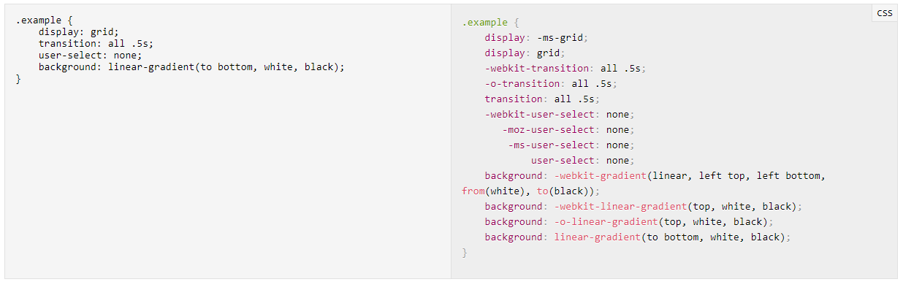
Autoprefixer
Autoprefixer is probably the most well-known PostCss plugin, as it’s used by notable tech companies such as Google, Twitter, and Shopify. It adds vendor prefixes to CSS rules where it’s necessary.

Slide 25
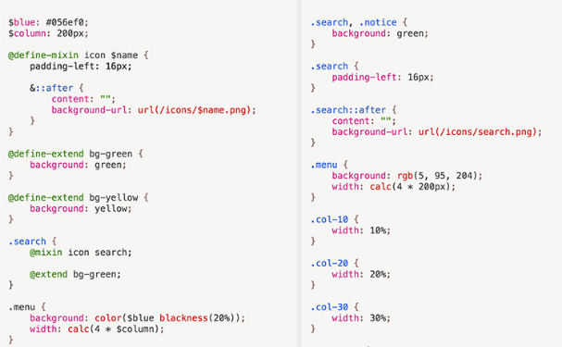
PreCSS
PreCSS is one of the PstCSS plugins that work like a CSS preprocessor. It makes it possible to take advantage of a Sass-like markup in your sytlesheet files.

Slide 26
Thank you!

